Slide 1
ENVIRONMENTAL ACTION LEVELS “EAL SURFER” APPLICATION
Roger Brewer, PhD (Senior Scientist)
Lynn Baily (Technical Development)
Department of Health
Hazard Evaluation & Emergency Response
HACC August 26, 2017

Slide 2
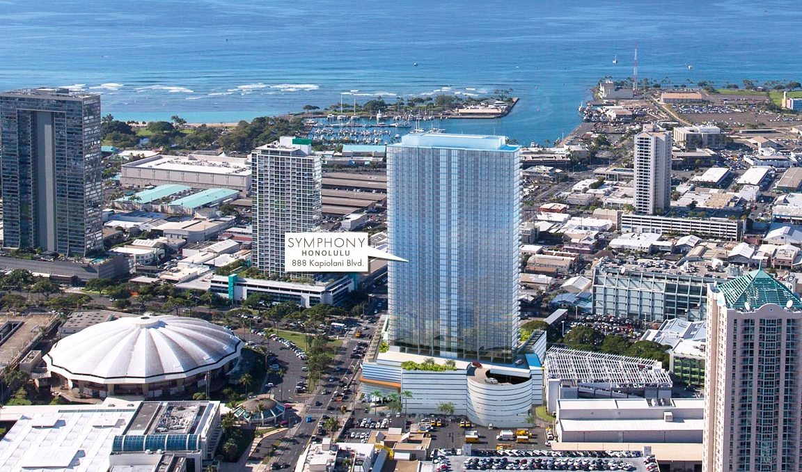
Symphony Park Development
Honolulu (2013-2016)
$100+ million development
300+ units, plus commercial
Two-year construction period
Notes:
Example redevelopment project that can involve the HEER office. We are also involved behind the scenes in testing of former industrial agricultural land for redevelopment and addressing spills of hazardous chemicals.

Slide 3

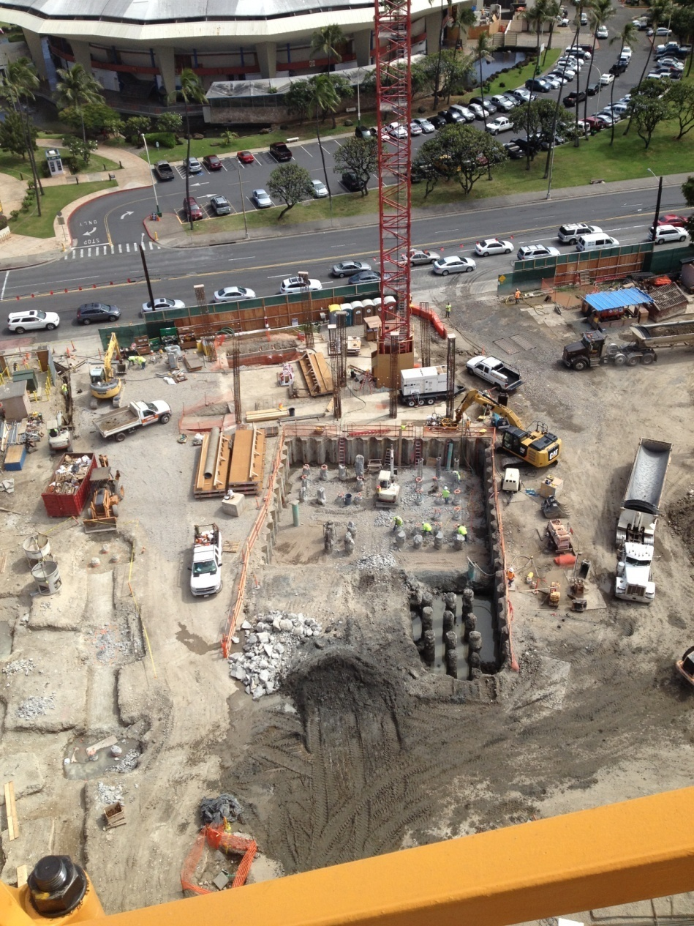
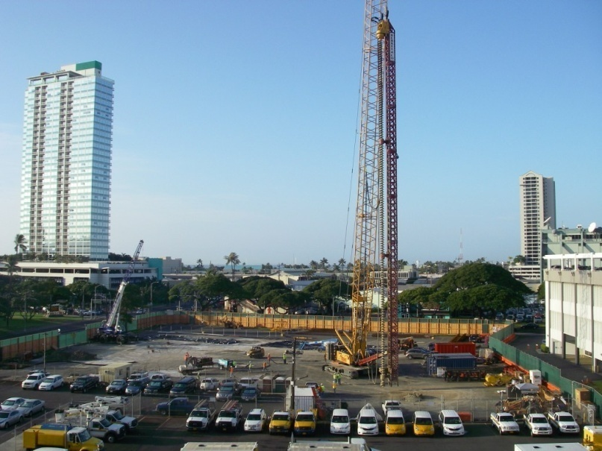
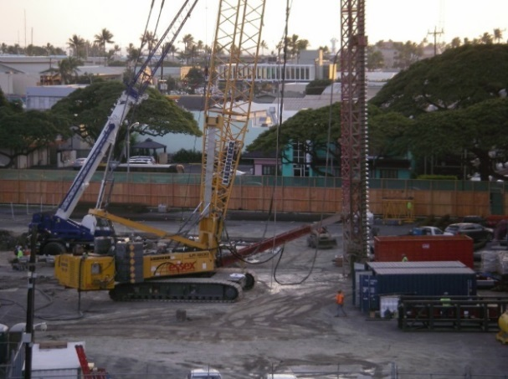
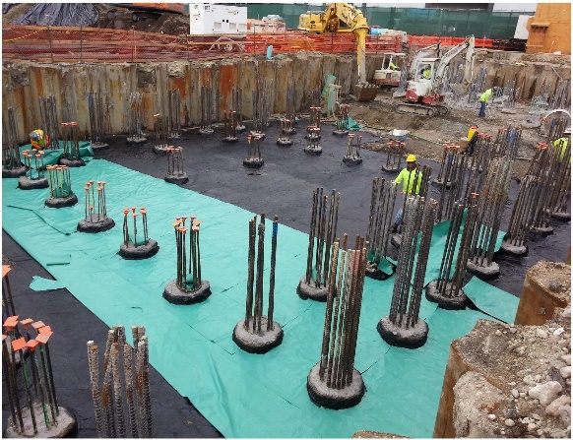
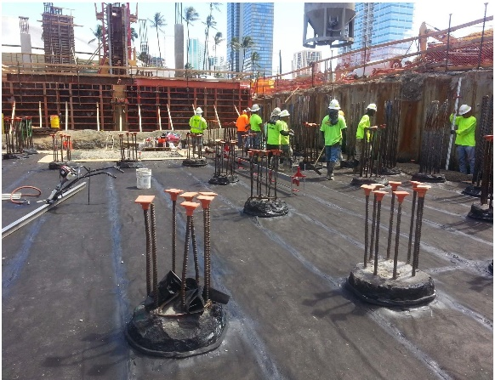
Unexpected Delays Can be Catastrophic
X
Notes:
Halting a large construction project after it has started can cause significant problems. Construction contracts signed months or years earlier. Penalties paid to contractors if developer halts or delays construction. Workers laid off. Businesses providing services to construction project hurt. Plans to move from current locations already made by future occupants of building.

Slide 4
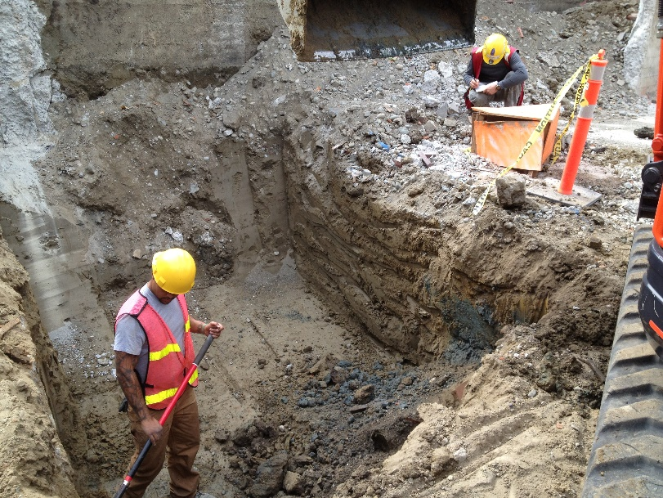
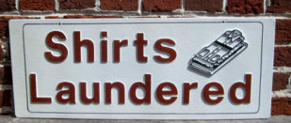
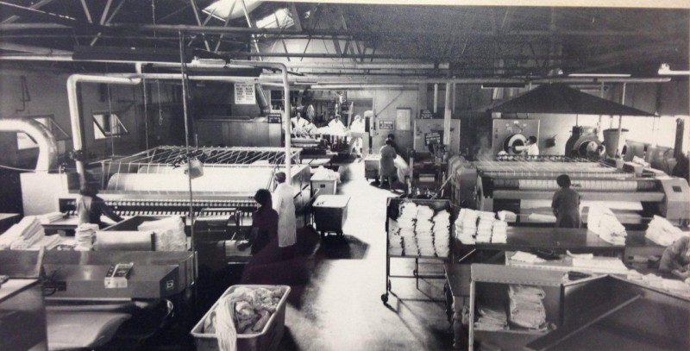
Surprise!
Laundromat operated on property in 1950s
Used dry cleaning fluid dumped on ground
Mauka half of property discovered to be heavily contaminated
Potential health risk to construction workers and future residents
Significantly interfered with scheduled construction
Notes:
Widespread contamination found just below the ground surface in the mauka half of the property. Vapors were so strong that workers walked off the job.

Slide 5
Identifying the Problem and Developing a Cleanup Plan is a Complex Task
1990s Average Time = 1 ½ Years!
Notes:
Test soil, water and air for contamination required. Past Process: Consult experts in human health and ecological risk assessment. Run models and estimate potential risk to workers and future residents. Develop cleanup plan. In the early 1990s the average time complete the assessment and initiate cleanup actions was over one year. The project would often be shut down until then.

Slide 6
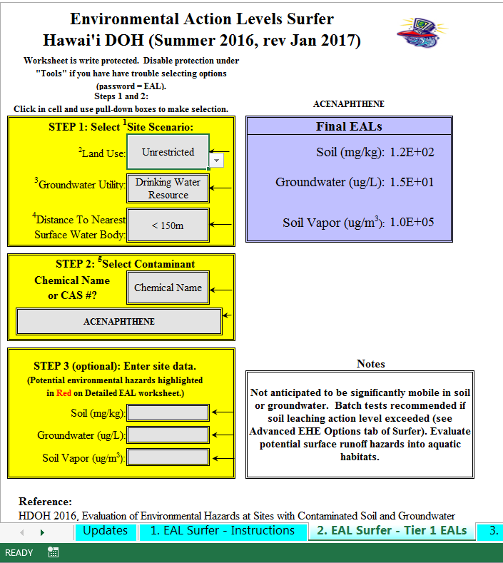
Expedited Hazard Identification with “Environmental Screening Levels (EALs)”
2010s Average Time = Minutes (maybe…)
EAL Surfer (Excel-based “Expert System”
Asks user a few simple questions:
Land use
Distance to water bodies and wells
Chemical of concern
Concentration in air, water and soil
“Surfs” for data from dozens of tables and models
Compares site data to HDOH “action levels”
Immediately identifies potential environmental problems
Generates automated report
Regularly updated
Notes:
Expedited approach to identify potential environmental hazards and develop cleanup plans started in mid-1990s. Evolved over the years into an easy-to-use (mostly), set of electronic Excel lookup tables and models. Three versions in existence. Similar versions used in California. Used informally in many states, plus Japan, Korea, Israel and other countries. Assisting development of similar Expert System in China.

Slide 7
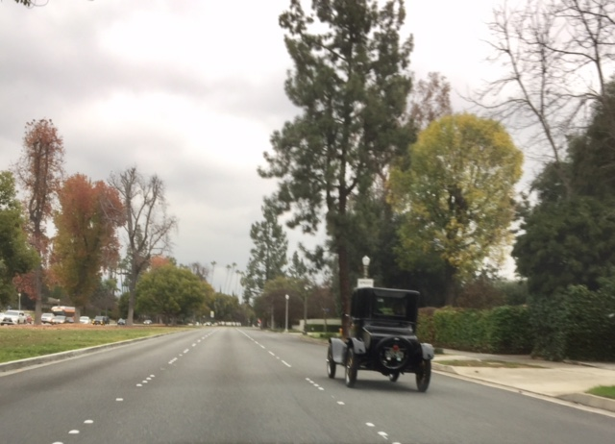
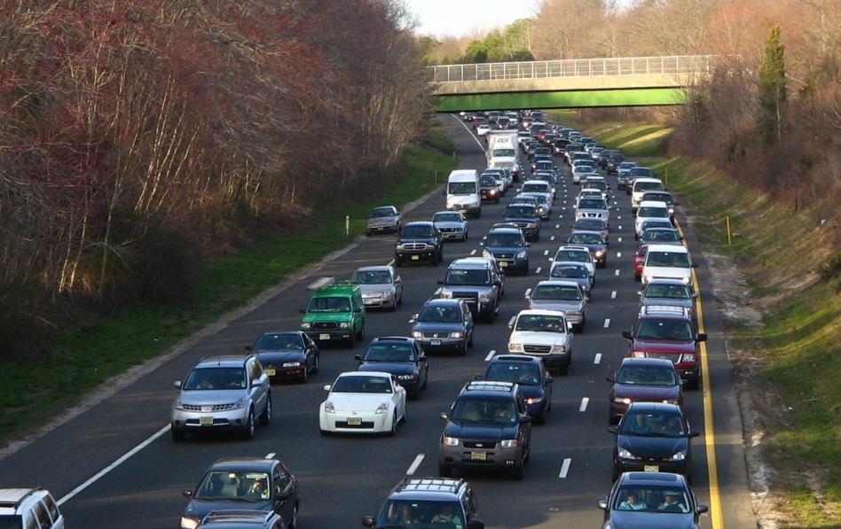
Great for It’s Time…
20th Century Cruising
21st Century Traffic Jams
At the limits of Excel
Only allows review of one chemical at a time
Automated reporting sheets inconvenient and not used
Project reports unclear and sometimes miss problems
Causes unnecessary delays in identification and cleanup of environmental contamination
Notes:
Current, Excel-based “EAL Surfer” is at it’s limit for improvement.

Slide 8
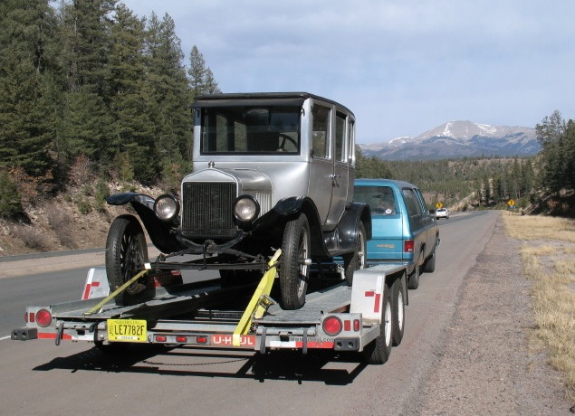
The Challenge: Add New Functionality to EAL Surfer Through Technology
HDOH EAL Surfer
Your App!
Create “Bolt-On” (?) to Excel-based, EAL Surfer program
Allow input of project scenario (pulldown list)
Allow selection of multiple chemicals (pulldown list)
Allow input of concentration of each chemical at site
Generate downloadable, summary report in pdf (?) format
Able to link to future updates of EAL Surfer
Notes:
Make it easy enough for Roger to use. Ensure that the integrity of the EAL surfer is retained. Generating erroneous “action levels” for a chemical could lead to significant harm to human health and the environment

